Slide 1
Some basic concepts of chemistry chapter-1

Slide 2
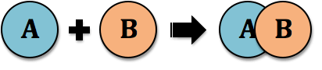
Laws of chemical combination

Slide 3
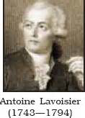
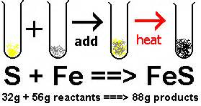
Law of conservation of mass:-
“Law of conservation of mass states that matter can neither be created nor be destroyed in a chemical reaction.”

Slide 4
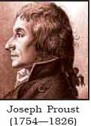
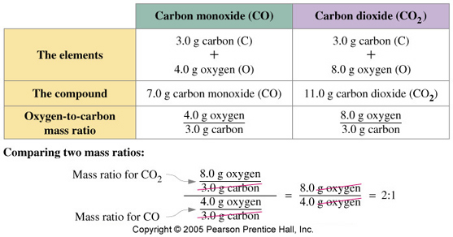
Law of definite proportions
“In given compound always contains exactly the same proportion of elements by weight.”

Slide 5
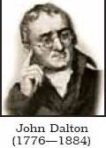
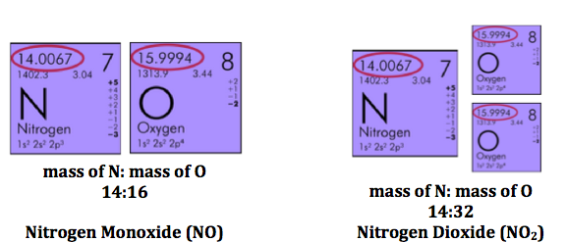
Law of multiple proportions
“if two elements can combine to form more than one compound, the masses of one element that combine with a fixed mass of the other element, are in the ratio of small whole numbers.”

Slide 6
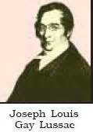
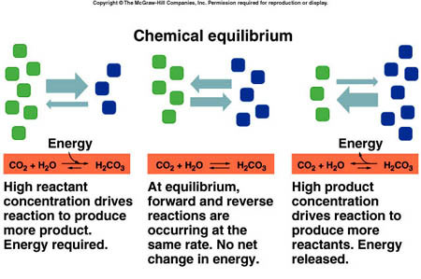
Gay lussac’s law of gaseous volumes
“when gases combine or are produced in a chemical reaction they do so in a simple ratio by volume provided all gases are at same temperature and pressure.”

Slide 7
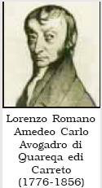
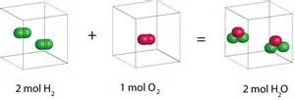
Avogadro's law
“Equal volumes of gases contain equal number of molecules at standard temperature and pressure.”

Slide 8
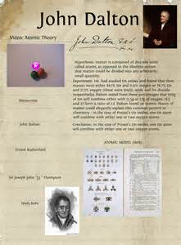
Daltons atomic theory
According to Dalton's atomic theory,
1)Matter consists of indivisible atoms.
2)All the atoms of a given element have identical properties including identical mass. Atoms of different elements differ in mass.
3)Compounds are formed when atoms of different elements combine in a fixed ratio.
4)Chemical reactions involve reorganisation of atoms. These are neither created nor destroyed in a chemical reaction.

Slide 9
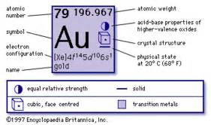
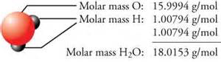
Atomic and molecular masses
One atomic mass unit is defined as a mass exactly equal to one- twelfth the mass of one carbon - 12 atom and 1 amu = 1.66056×10^{–24} g .
Today, ‘amu’ has been replaced by ‘u’ which is known as unified mass.

Slide 10
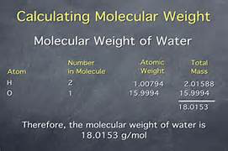
Molecular mass and formula mass
Molecular mass is the sum of atomic masses of the elements present in a molecule. It is obtained by multiplying the atomic mass of each element by the number of its atoms and adding them together.
Formula unit mass is the empirical formula of the compound.

Slide 11
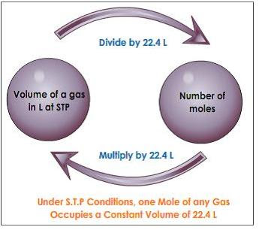
Mole concept
One mole is the amount of a substance that contains as many particles or entities as there are atoms in exactly 12 g of the 12_{C} isotope.
1 mol of atom = 6.022×10²³ entities.
The mass of one mole of a substance in grams is called its molar mass.

Slide 12
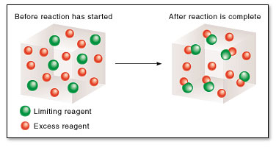
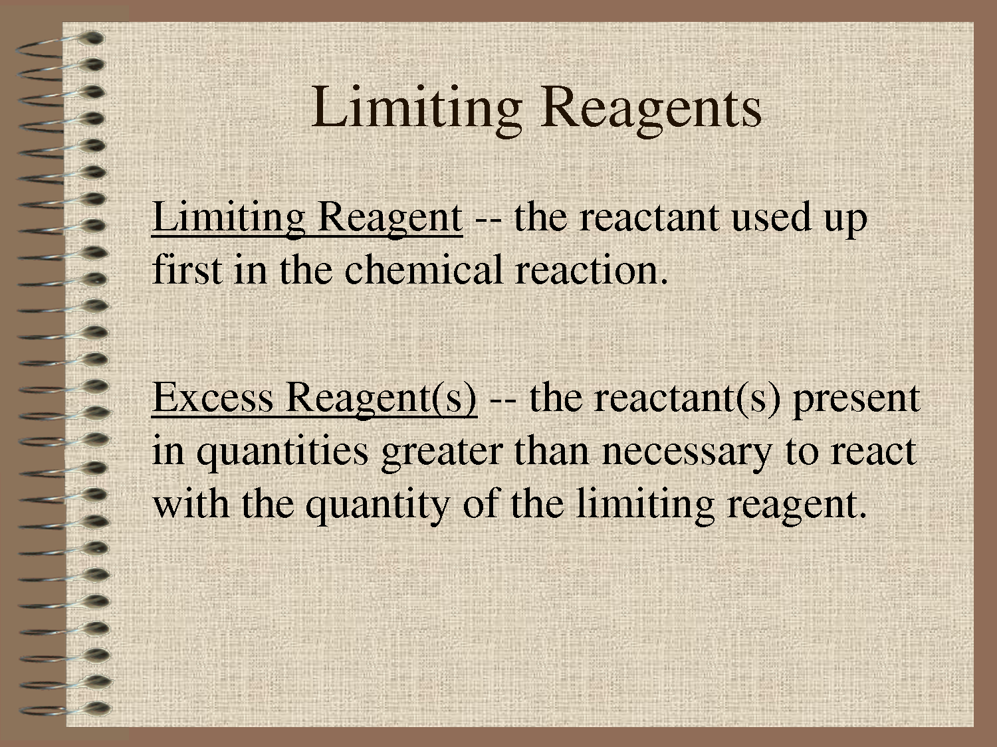
Limiting reagent
When any reaction is carried out if the reactants are not present in the amounts as required by a balanced chemical reaction.
In such situations, one reactant is in excess over the other. The reactant which is present in the lesser amount gets consumed after sometime and after that no further reaction takes place whatever be the amount of the other reactant present.
Hence, the reactant which gets consumed, limits the amount of product formed and is, therefore, called the limiting reagent.

Slide 13
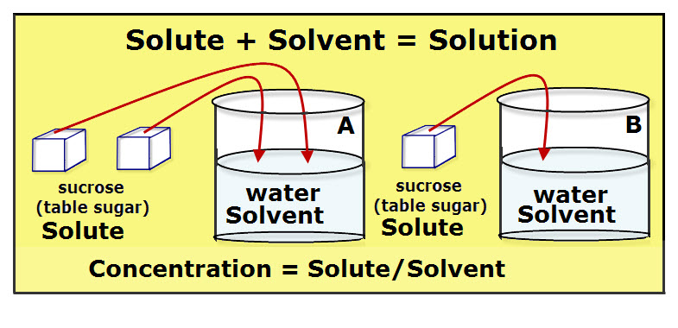
Concentrations in solutions
The concentration of a solution is expressed in 4 different ways.
Mass percent
Mole fraction
Molarity
molality

Slide 14
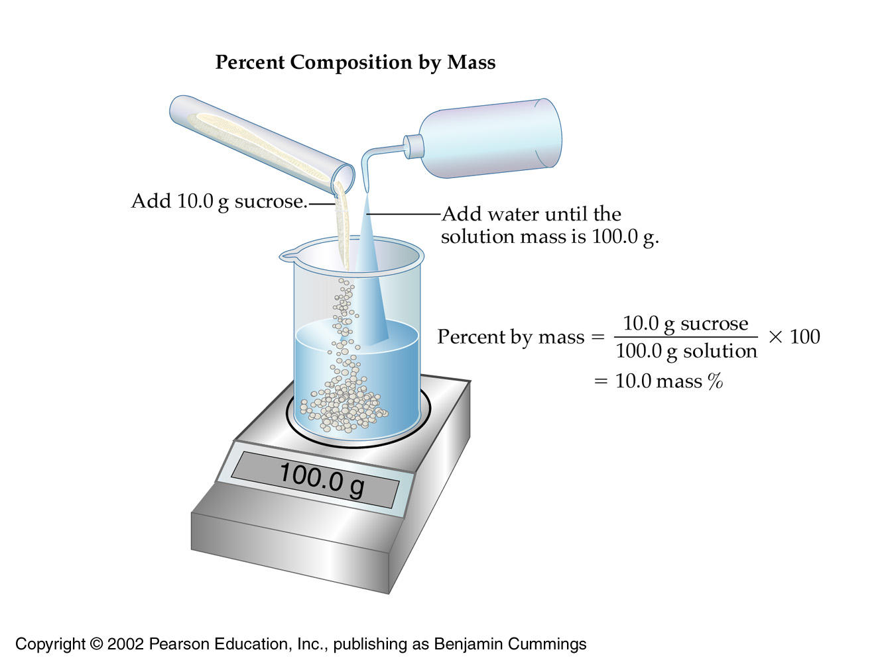
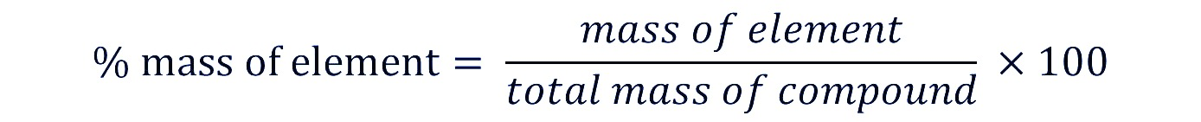
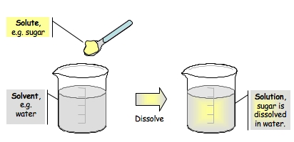
Mass percentage
Mass % of a compound is given by the formula
Mass percentage is used by only binary solutions
It is used for calculation of very small quantities

Slide 15
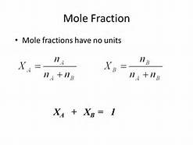
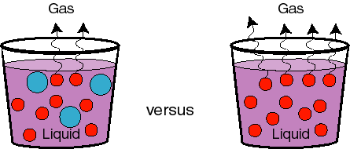
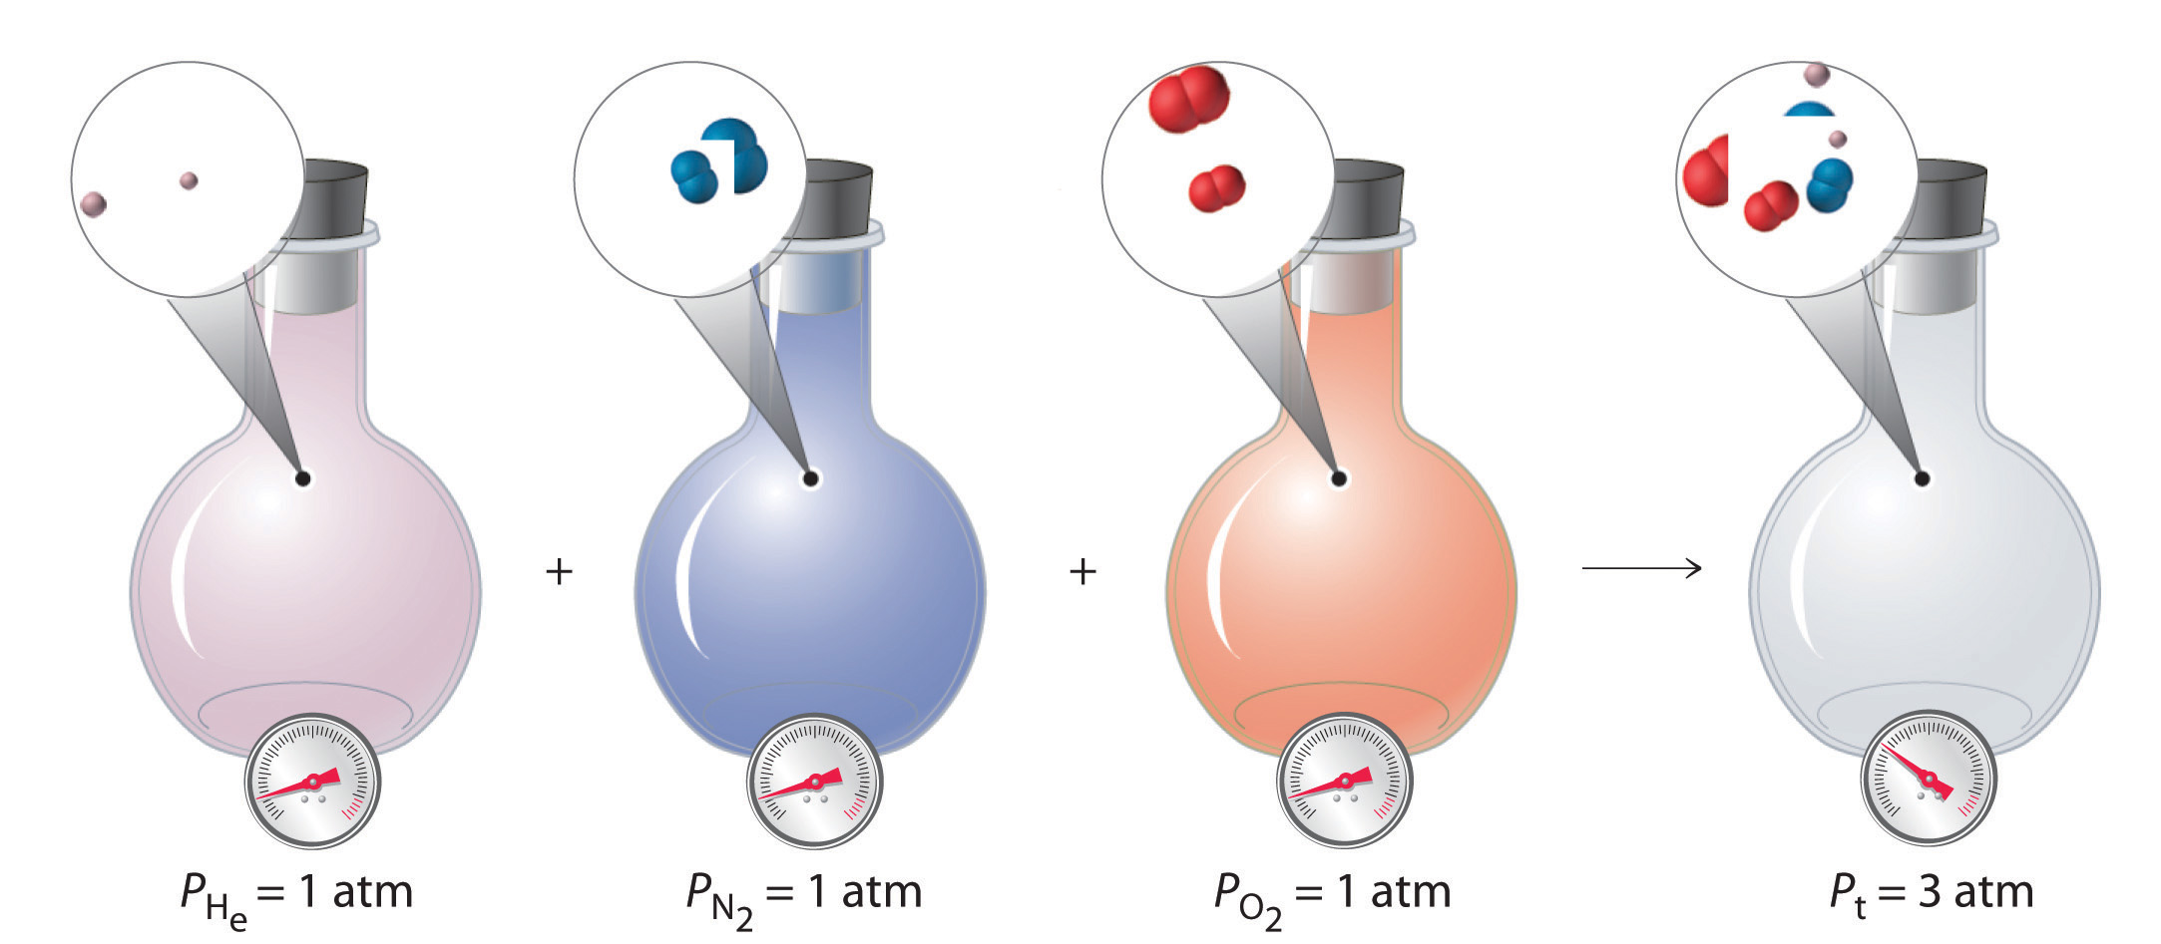
Mole fraction
It is defined as the ratio of number of moles of a particular component to the total number of moles of the solution. If a substance ‘A’ dissolves in substance ‘B’ and their number of moles are n_{A} and n_{B} respectively; then the mole fractions of A and B are given as X_{A} and X_{B}
Mole fraction is a dimensionless quantity

Slide 16
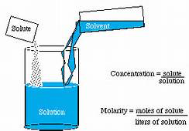
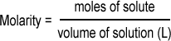
Molarity
It is the most widely used unit and is denoted by M. It is defined as the number of moles of the solute in 1 litre of the solution. Therefore
molarity of a solution depends upon temperature because volume of a solution is temperature dependent.

Slide 17
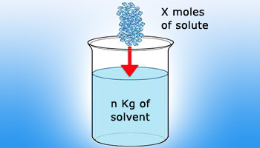
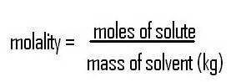
Molality
It is defined as the number of moles of solute present in 1 kg of solvent. It is denoted by m.
molality of a solution does not change with temperature because volume of a solution is temperature independent

Slide 18
Two main concentrations of solutions
molarity
molality
It is the most widely used unit and is denoted by M. It is defined as the number of moles in solute upon volume of solution in litres(L).
Molarity= no of moles in solute/volume of solution in litres.
Molarity is not preferred
It is defined as the number of moles of solute present in 1 kg of solvent. It is denoted by (m).
Molality= no of moles in solute/ mass of solvent in kg.
Molality is preferred

Slide 19
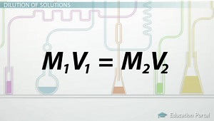
Concepts in molarity
In some cases to find the mass of a certain compound volume of a compound , mass of the second compound and volume of the second compound will be given in that case we apply the formula :-

Slide 20
Another very important formula used in molarity is finding molarity using density.
The formula is
M = % x d x10
mass
Example question:
Commercially available sulphuric acid contains 93% by mass and has has a density of 1.84 g/cm³ . Calculate the molarity of the solution and the volume of concentrated acid required to prepare 2.5mL of 0.50 M of H₂SO₄.

Slide 21
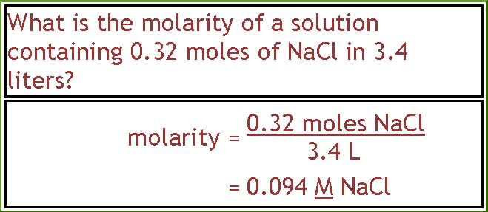

Slide 22
Examples on molality
What is the molality of a solution consisting of 1.34 mL of carbon tetrachloride (CCl₄, density= 1.59 g/mL) in 65.0 mL of methylene chloride (CH₂Cl₂, density = 1.33 g/mL)?
1) Moles CCl₄:
1.34 mL times 1.59 g/mL = 2.1306 g
2.1306 g / 153.823 g/mol = 0.013851 mol
2) Calculate the Mass of the methylene chloride:
65.0 mL times 1.33 g/mL = 86.45 g = 0.08645 kg
3) Calculate the Molality:
0.013851 mol / 0.08645 kg = 0.160 m
Solution:-

